Slide 1
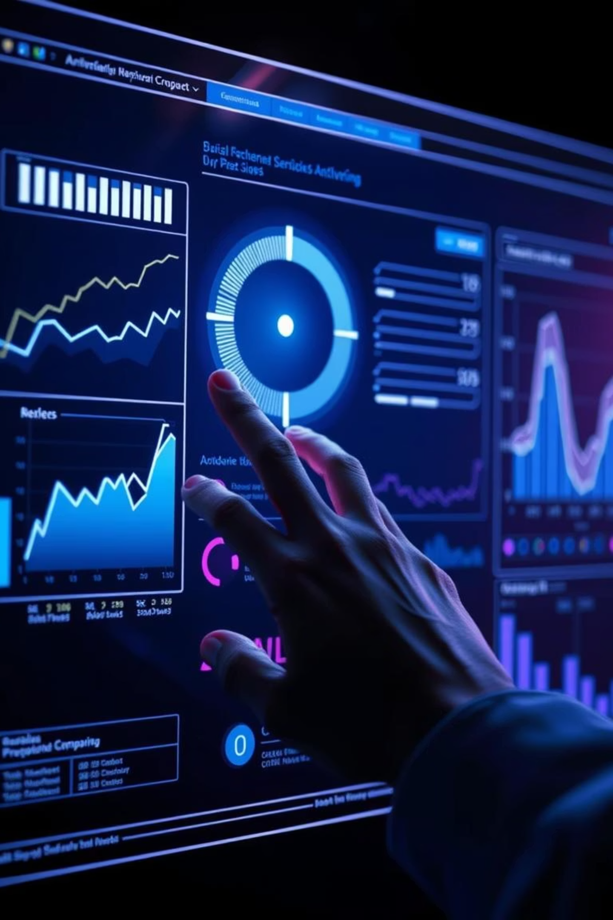
GenAI-Powered Sales Data Analysis Assistant
Transforming natural language queries into actionable business intelligence.

Slide 2
Chapter 1
Introduction: Bridging the Data Gap
The global self-service business intelligence market is projected to grow from USD 6.73 billion in 2024 to USD 26.54 billion by 2032, reflecting a surging demand for accessible analytics. Despite vast enterprise data, only 20% of BI tools achieve meaningful adoption due to complexity and technical skill requirements.
Generative AI (GenAI) offers a transformative opportunity to democratize data access by enabling users to interact with data using plain English, bridging the gap between human language and structured database queries.

Slide 3
Business Impact & Urgency
Decision-Making Bottlenecks
Underutilized Data Assets
Non-technical stakeholders face delays, missing time-sensitive opportunities.
41% cite complex processes, 45% report frequent delays.
Skills Gap & Constraints
Competitive Disadvantage
Shortage of data science and SQL expertise limits analytical agility.
Organizations risk falling behind without rapid data analysis capabilities.

Slide 4
Problem Statement: Challenges in Data Analysis
Complexity of Data Handling
Knowledge Barrier
Limited Self-Service
Most business users lack SQL expertise, hindering independent insights.
Existing BI tools have steep learning curves, reducing adoption.
Messy, inconsistent data requires extensive preprocessing.
Inefficient Workflows
Integration Challenges
Report requests cause delays and missed opportunities.
Bringing data from multiple sources is cumbersome.

Slide 5
Project Objectives
Technical Goals
Functional Goals
Automated data preprocessing pipeline.
Intuitive Streamlit UI (conversational AI & dashboards).
Robust MySQL database integration.
Real-time query processing (under 10 seconds).
AI-driven query translation (GPT-4o-mini).
Comprehensive Plotly visualization capabilities.
Scalable FastAPI backend architecture.
Seamless Power BI integration.
This project aims to bridge the gap between complex enterprise data and accessible business intelligence.

Slide 6
Chapter 2
Existing Methods & Our Approach
Current Landscape
Our Innovation
Academic Text-to-SQL: Spider 2.0 benchmark shows only 15.1% success on enterprise challenges.
End-to-End Architecture: Complete data preprocessing, unlike most academic solutions.
Commercial BI Platforms: ThoughtSpot, Looker, Lightdash offer varying degrees of natural language and modeling.
Hybrid Interface: Combines conversational AI with traditional BI dashboards.
LLM-Based Solutions: High performance but face data privacy and API limitations.
Real-time Schema Extraction: Informs LLM for accurate query generation.
Performance & Usability: Sub-10-second response times and guided user experience.

Slide 7
Chapter 3
System Design & Methodology
The GenAI-powered Sales Data Analysis Assistant utilizes a comprehensive sales dataset (10,000 to 1,000,000 transaction records) with temporal, geographic, product, customer, and financial dimensions.
01
02
Data Loading & Assessment
Text Data Standardization
Robust Excel data loading with error handling and column cleanup.
Consistent formatting for product names, cities, and categories.
03
04
Temporal Data Processing
Numeric Data Normalization
Feature engineering for time-series analysis.
StandardScaler for optimal analytical performance.

Slide 8



Architectural Overview
Data Tier
Application Tier
Presentation Tier
MySQL database optimized for analytical queries.
FastAPI REST service for NLP and database interaction.
Streamlit web application for interactive user experience.
This three-tier distributed architecture ensures scalability and clear separation of concerns.

Slide 9
Chapter 4
Implementation Details
Key Technologies
System Workflow
Python 3.8+: Primary programming language.
System Initialization & Startup.
MySQL-compatible SQL: Database operations.
Automated ETL Pipeline Execution.
FastAPI 0.100+: High-performance backend.
Natural Language Query Processing.
Streamlit 1.28+: Interactive frontend.
Database Execution & Result Processing.
Pandas 2.0+: Data manipulation.
Interactive Visualization & Dashboard Generation.
Scikit-learn 1.3+: Numeric normalization.
Plotly 5.15+: Interactive visualizations.
OpenAI GPT-4o-mini: Natural language to SQL translation.

Slide 10
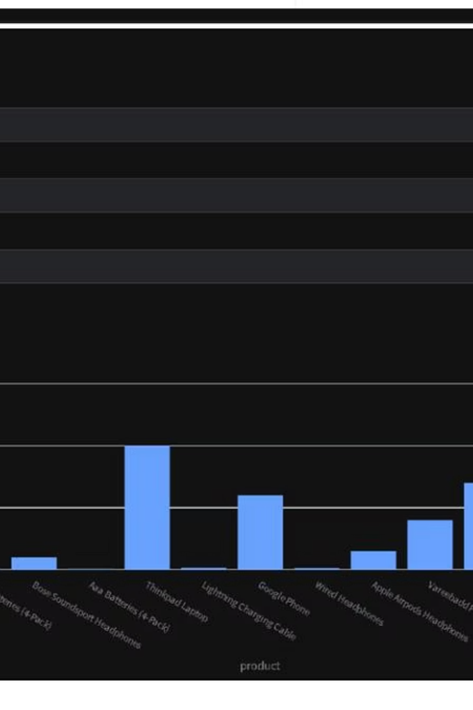
Results & Impact
Key Achievements
Future Directions
SQL Generation Accuracy: 92.3% (vs. 77-85% industry average).
Advanced AI (multi-modal, proactive analytics).
Enterprise-grade security & governance.
Response Time: 8.4 seconds end-to-end (vs. 15-30 min traditional).
Enhanced data integration (streaming, cloud warehouses).
User Adoption: 73% within first week.
Performance & scalability enhancements.
Self-Service Success: 88% of questions answered without IT.
Industry-specific specializations.
Analytical Agility: 96% improvement (24-48 hours to 12 minutes).

